Slide 1
How do you deal with dYSPEPSIA AND IBS in 2019?
DR TALAL AL-TAWEEL
Head of gastroenterology unit
Jaber al-ahmad al-sabah hospital
April 2019

Slide 2
Disclosures
Honoraria: Tillots

Slide 3
Dyspepsia

Slide 4
Definition
Etymology: two ancient Greek words
dys (bad, abnormal, difficult, impaired)
pepsis (digestion)
NOT a diagnosis but a symptom complex

Slide 5
Rome IV definition
One or more of the following:
Epigastric pain
Epigastric burning
Post-prandial fullness
Early satiation
It should NOT be called dyspepsia if the predominant symptoms are heartburn or acid regurgitation
Stanghellini et al, Gastroenterology. 2016 May;150(6):1380-92.

Slide 7
Acg/cag definition
Symptom complex of epigastric pain or discomfort thought to originate in the upper gastrointestinal tract, and it may include any of the following symptoms:
heartburn
acid regurgitation
excessive burping/belching
bloating
nausea
feeling of abnormal or slow digestion
early satiety
Am J Gastroenterol advance online publication, 20 June 2017; doi:10.1038/ajg.2017.154

Slide 8
Burden of dyspepsia
Prevalence of dyspepsia : 20-40%
Incidence 1% per year
70% of patients with dyspepsia have FD
Significant reduction of patients quality of life
Significant economic burden to healthcare system
Patients tend to remain symptomatic with 61% using drugs and 43% having gastrointestinal procedures at 1 year, indicating intensive use of medical resources
Marwaha et al. DDW 2009
Ford et al. Clin Gastr Hepatol 2010

Slide 9
Causes of dyspepsia
Reflux esophagitis
Normal
23.9%
33.6%
2%
Cancer
19.9%
20.8%
Peptic ulcer disease
Gastritis/duodenitis
Richter et al. Scand J Gastroenterol Suppl. 1991
Notes:
Patients with dyspepsia may have underlying organic lesions
Among patients diagnosed as having dyspepsia, 60–80% may have underlying organic lesions. Reflux esophagitis is frequently the most common such lesion, occurring in up to 1 in 4 dyspeptic patients.²³⁻²⁵
In a group of 3667 primary care patients in the UK with a clinical diagnosis of dyspepsia, over 60% were subsequently diagnosed endoscopically as having an organic lesion, and over 20% of the dyspeptic patients had reflux esophagitis²⁵. However, given the prevalence of dyspepsia, it is not feasible to refer all patients for endoscopy, and the physician has to make a decision on who should be treated empirically and who should receive further investigation.

Slide 10
Helicobacter pylori
The role of H. pylori in PUD has been well documented in the literature since the initial landmark Lancet article by Marshall and Warren in 1983
90% to 95% of duodenal ulcers
60% to 80% of gastric ulcers.
WHO group I carcinogen in humans
Development of gastric cancer is multifactorial process that includes other factors such as diet high in salt, low in vitamin C and smoking.
Overall risk of gastric cancer in the world other than far east is low
Cost-effective to test for in dyspepsia if prevalence in population > 10%

Slide 11
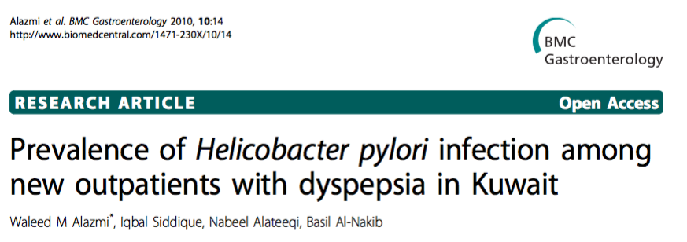
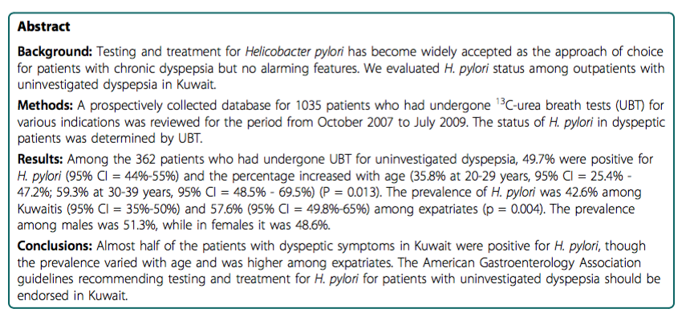

Slide 12
HSC Poster Day 2016

Slide 13
Uninvestigated Dyspepsia
Consider :
- Cardiac
- Hepatobiliary
- Medication-induced
- Dietary indiscretion
- Other
Treat as appropriate
(A)
Other possible causes ?
YES
First Visit
van Zanten et al. CMAJ. 2000 Jun 13;162(12 Suppl):S3-23.

Slide 14
Step a
Exclude other possible causes of the dyspeptic symptoms with thorough history-taking and physical examination
Cosnider
Cardiac and hepatobiliary causes
Medication-induced symptoms
Possible dietary indiscretion
Lifestyle or other causes

Slide 15
Uninvestigated Dyspepsia
Consider :
- Cardiac
- Hepatobiliary
- Medication-induced
- Dietary indiscretion
- Other
Treat as appropriate
(A)
Other possible causes ?
YES
No
(B)
Age >60 or alarm features?
- Vomiting
- Bleeding anemia
- Abdominal mass/
unexplained weight loss
- Dysphagia
YES
Investigate
(endoscopy recommended)
First Visit
van Zanten et al. CMAJ. 2000 Jun 13;162(12 Suppl):S3-23.

Slide 16
ALARM SYMPTOMS
Recurrent vomiting
Significant, unintentional weight loss (> 10% of TBW)
Hematemesis/melena
Unexplained IDA
Abdominal mass
Dysphagia
Age > 60

Slide 17
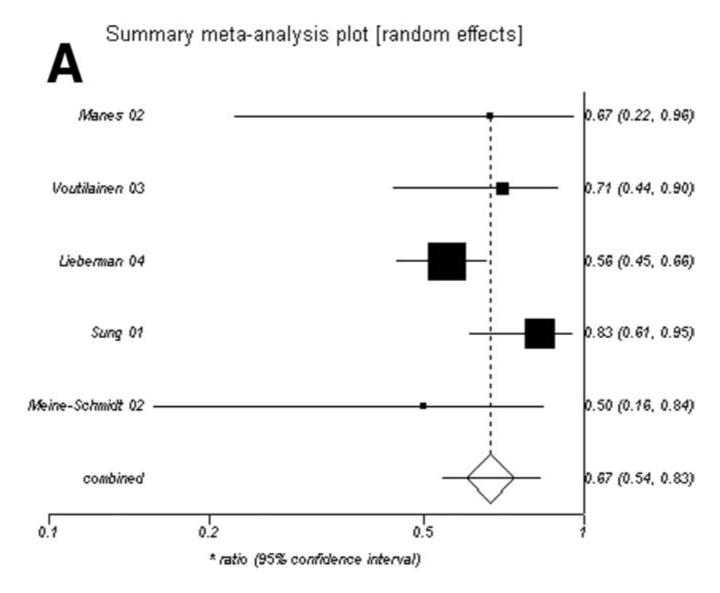
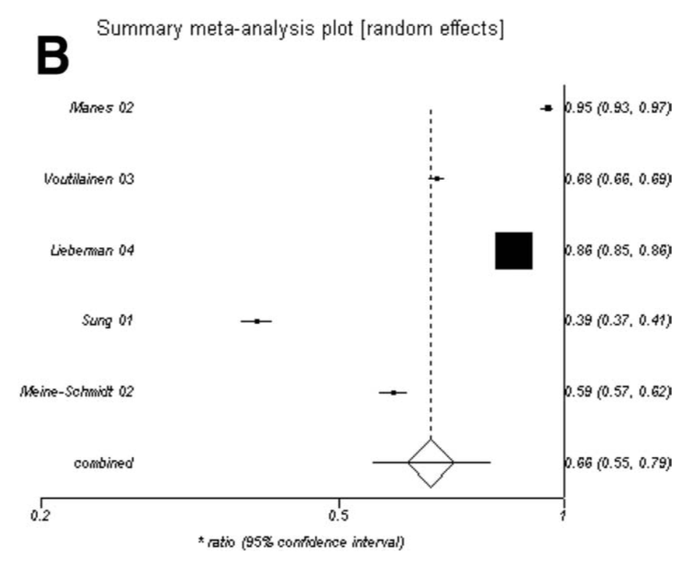
Value of Alarm features in detecting upper gi neoplasia
Systematic review and meta-analysis, 15 studies, total of 57,363 patients ➔ 0.8% had cancer
Sensitivity
Specificity
Vakil et al. Gastroenterology 2006;131:390–401

Slide 18
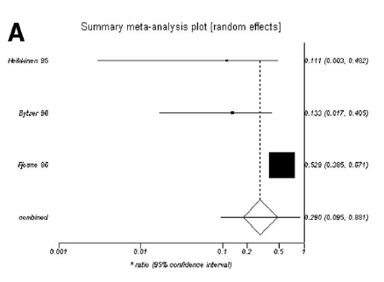
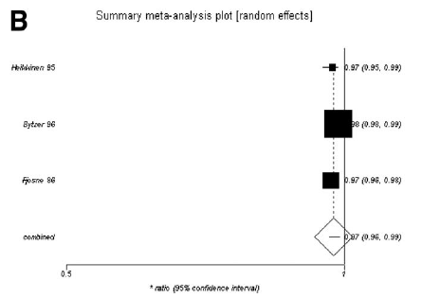
Value of Clinical opinion in detecting upper gi neoplasia
Sensitivity
Specificity
Vakil et al. Gastroenterology 2006;131:390–401

Slide 19
So how should we do with alarm features in dyspepsia?
Consider if prominent alarm feature (e.g., weight loss > 10 kg or rapidly progressive dysphagia) or if a combination of features were present.
Current data have not evaluated severe symptoms or combinations of features, so the need for endoscopy needs to be evaluated on a case-by-case basis in these circumstances using clinical judgment.
Risk also increases with age e.g. threshold to refer for upper GI endoscopy would be lower in a 58-year-old compared to a 28-year-old with dyspepsia and alarm features.
Family history of upper GI malignancy would also factor into any endoscopy decision.

Slide 20
Uninvestigated Dyspepsia
Consider :
- Cardiac
- Hepatobiliary
- Medication-induced
- Dietary indiscretion
- Other
Treat as appropriate
(A)
Other possible causes ?
YES
No
(B)
Age >60 or alarm features?
- Vomiting
- Bleeding anemia
- Abdominal mass/
unexplained weight loss
- Dysphagia
YES
Investigate
(endoscopy recommended)
First Visit
NO
(C)
NSAID and/or
Regular ASA
Use?
YES
NSAID Management
van Zanten et al. CMAJ. 2000 Jun 13;162(12 Suppl):S3-23.

Slide 21
Nsaid users
HP is most common cause of peptic ulcers
NSAIDs are responsible for most of HP negative ulcers

Slide 22
NSAID and/or regular ASA use
Can NSAID/ASA
be stopped?
YES
Stop therapy
YES
NO
Patient improved?
End
Treat or investigate a. PPI b. Cytoprotective agent c. High-dose H₂-RA d. Switch to COX-2 inhibitor e. Eradicate HP!
NO
van Zanten et al. CMAJ. 2000 Jun 13;162(12 Suppl):S3-23.

Slide 24
Uninvestigated Dyspepsia
Consider :
- Cardiac
- Hepatobiliary
- Medication-induced
- Dietary indiscretion
- Other
Treat as appropriate
(A)
Other possible causes ?
YES
No
(B)
Age >60 or alarm features?
- Vomiting
- Bleeding anemia
- Abdominal mass/
unexplained weight loss
- Dysphagia
YES
Investigate
(endoscopy recommended)
First Visit
NO
(C)
NSAID and/or
Regular ASA
Use?
YES
NSAID Management
NO
(D)
Is dominant symptom
heartburn and/or
regurgitation ?
YES
Treat as reflux
van Zanten et al. CMAJ. 2000 Jun 13;162(12 Suppl):S3-23.

Slide 25
Reflux mini-management schema
Dominant symptom heartburn and/or regurgitation
Treat with standard dose PPI Reassess at 4-8 weeks
YES
Symptoms
Resolved?
NO
Treat - Double dose x 4-8 weeks or consider investigation
Symptoms
resolved?
YES
Stop therapy (if symptoms recur,
repeat original therapy)
NO
van Zanten et al. CMAJ. 2000 Jun 13;162(12 Suppl):S3-23.
Investigate

Slide 26
Uninvestigated Dyspepsia
Consider :
- Cardiac
- Hepatobiliary
- Medication-induced
- Dietary indiscretion
- Other
Treat as appropriate
(A)
Other possible causes ?
YES
No
(B)
Age >60 or alarm features?
- Vomiting
- Bleeding anemia
- Abdominal mass/
unexplained weight loss
- Dysphagia
YES
Investigate
(endoscopy recommended)
First Visit
NO
(C)
NSAID and/or
Regular ASA
Use?
YES
NSAID Management
NO
(D)
Is dominant symptom
heartburn and/or
Regurgitation ?
YES
Treat as reflux
NO
(E)
Hp test positive?
1. UBT
2. Serology
YES
Treat as HP positive

Slide 27
Functional dyspepsia
One or more of the following:
Epigastric pain
Epigastric burning
Post-prandial fullness
Early satiation
AND
No evidence of structural disease (including at upper endoscopy) that is likely to explain symptoms
Stanghellini et al, Gastroenterology. 2016 May;150(6):1380-92.

Slide 28
Fd subtypes: epigastric pain syndrome
1 of the following symptoms at least 1 day a week:
Epigastric pain (severe enough to impact on usual activities)
AND/OR
Epigastric burning (severe enough to impact on usual activities)
No evidence of organic, systemic, or metabolic disease that is likely to explain the symptoms on routine investigations (including at upper endoscopy)
Stanghellini et al, Gastroenterology. 2016 May;150(6):1380-92.

Slide 29
Fd subtypes: Post-prandial distress syndrome
One or both of the following at least 3 days per week:
Postprandial fullness (severe enough to impact on usual activities)
Early satiation (severe enough to prevent finishing a regular-size meal)
No evidence of organic, systemic, or metabolic disease that is likely to explain the symptoms on routine investigations (including at upper endoscopy)
Postprandial epigastric pain or burning, epigastric bloating, excessive belching, and nausea can also be present
Stanghellini et al, Gastroenterology. 2016 May;150(6):1380-92.

Slide 30
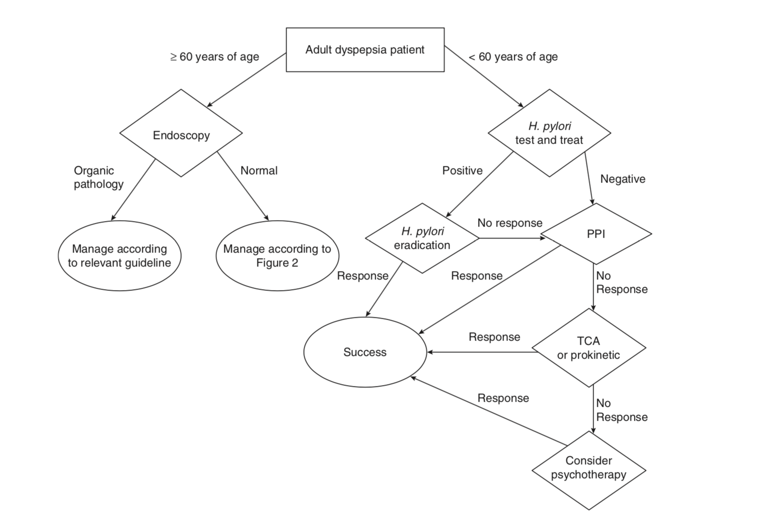
Standard once daily dose x 8 weeks
Consider EGD
TCA > SSRI > prokinetic
Am J Gastroenterol advance online publication, 20 June 2017; doi:10.1038/ajg.2017.154

Slide 31
Irritable bowel syndrome

Slide 34
Rome iv criteria for ibs
Lacy B et al, Gastroenterology. 2016 May;150(6):1380-92

Slide 35
IBS subtypes
IBS-C: Irritable bowel syndrome with predominant constipation
IBS-D: Irritable bowel syndrome with predominant diarrhea
IBS-M: Irritable bowel syndrome with predominant irregular bowel habits (mixed diarrhea and constipation)
REMEMBER TO WRITE IBS NOT IBD!!

Slide 36
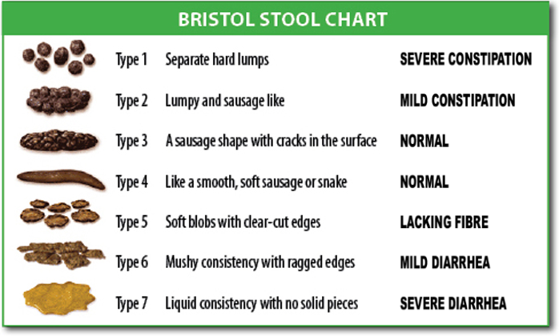

Slide 38
Alarm signs for ibs
Unintentional weight loss (> 5 % in 3 months)
Blood in stools not caused by hemorrhoids or anal fissures
Abnormal labs: anemia, low albumin, liver tests, elevated CRP, ESR or fecal calprotectin
Family history of IBD, GI cancer or celiac disease
Age > 45 years

Slide 39
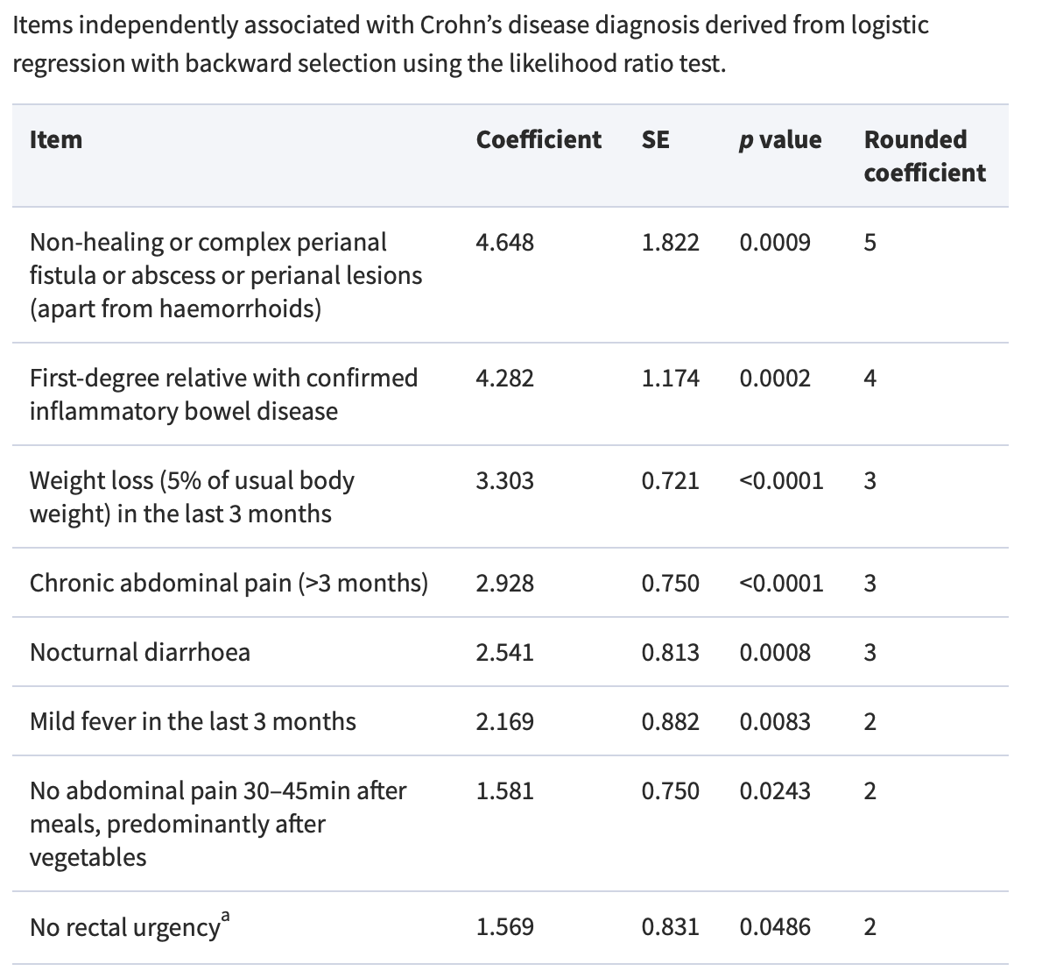
RED FLAG INDEX
Red flag index ≥ 8 points associated with 94% sensitivity and specificity for CD
Danese S Journal of Crohn's and Colitis, Volume 9, Issue 8, August 2015, Pages 601–606,

Slide 40
Biopsychosocial conceptual model
Drossman DA et al. Gastroenterology 2002;123:2108-2131

Slide 41
Recommended baseline tests
Complete blood count (CBC)
Erythrocyte sedimentation rate (ESR)
C-reactive protein (CRP)
Antibody testing for celiac disease (endomysial antibodies [EMA] or tissue transglutaminase [TTG]).
Faecal calprotectin (esp. in IBS-D)
NICE CG61 April 2017

Slide 42
Unecessary tests
Abdominal ultrasound
Flexible sigmoidoscopy or colonoscopy
Barium enema
Thyroid function test
Faecal ova and parasite test
Faecal occult blood
Hydrogen breath test (for lactose intolerance and bacterial overgrowth)
NICE CG61 Feb 2008

Slide 43
Management: dietary and lifestyle advice
Assess the physical activity levels of people with IBS, ideally using the General Practice Physical Activity Questionnaire (GPPAQ), if low should encourage to increase.
General dietary advice
Regular meals and take time to eat.
Avoid missing meals or leaving long gaps between eating.
Drink at least 8 cups of water per day, especially water or other non-caffeinated drinks, for example herbal teas.
Restrict tea and coffee to 3 cups per day.
Reduce intake of alcohol and fizzy drinks.
People with diarrhoea should avoid sorbitol, an artificial sweetener found in sugar-free sweets (including chewing gum) and drinks, and in some diabetic and slimming products.

Slide 44
Management: dietary and lifestyle advice
Fibre
Review the fibre intake of people with IBS, adjusting it while monitoring the effect on symptoms.
People with IBS should be discouraged from eating insoluble fibre (for example, bran).
If an increase in dietary fibre is advised, it should be soluble fibre such as ispaghula powder or foods high in soluble fibre (for example, oats).

Slide 45
Management: dietary and lifestyle advice
Probiotics:
Modest benefit especially with combination products there is insufficient evidence for any particular species.
If used, should be taken for at least 4 weeks before assessing response
If a person's IBS symptoms persist while following general lifestyle and dietary advice, consider single food avoidance and exclusion diets
Low FODMAP [fermentable oligosaccharides, disaccharides, monosaccharides and polyols] diet)
Gluten-free diet for suspected gluten intolerance

Slide 46
Management: pharmacological therapy
Cause smooth-muscle relaxation by either
Direct effect (e.g., mebeverine, pinaverium)
Anticholinergic or antimuscarinic properties (e.g. otilonium)
Practical approach
Give 30 min pre-meals as needed for postprandial symptoms
Not optimal choice for chronic or severe abdominal pain
Side effects: Dry mouth, constipation, urinary retention, visual disturbances

Slide 47
Management: pharmacological therapy
Antispasmodics available in Kuwait
Mebeverine (Duspatalin and Duspatalin RTM)
Dose: One capsule three times daily 20-30 mins before meals (twice daily for long acting preparation)
Otilonium (SpasmomenTM)
Dose: 1 tablet twice to three times daily
Pinavarium (DicetelTM)
Dose: 50-100 mg three times daily
Peppermint oil (ColperminTM)
Dose: 1-2 capsules three times daily

Slide 48
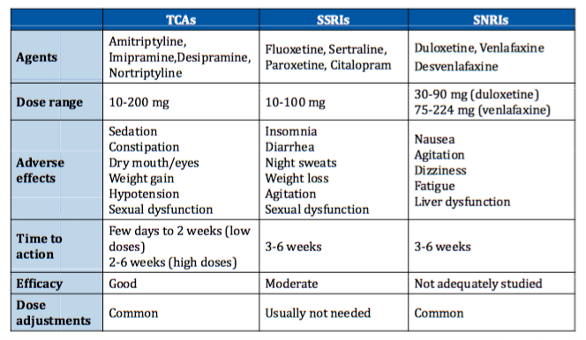
Antidepressants in ibs
Grover M, Drossman DA. Gastrointest Endoscopy Clin N Am. 2009;19:151-170

Slide 49
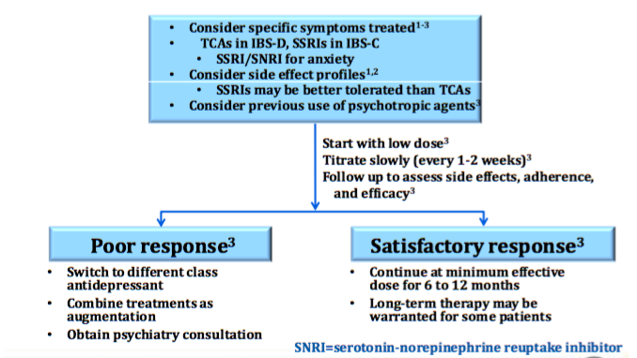
Antidepressants: clinical considerations
ACG Task Force on IBS. Am J Gastroenterol. 2009; 104(suppl 1):S1-S35
Ford AC, et al. Gut. 2009; 58:367 Grover M, Drossman A. Curr Opin Pharmacol. 2008; 8:715

Slide 50
constipation
Stress importance adequate fluid and fibre daily intake (may need MORE in the Kuwait summer!)
Aim is for 2 SBM/ week and Bristol Stool Form Scale type 4
Bulk-forming agents (predom. soluble fibre)
Sterculia/frangula (Normacol PlusTM)
Ispaghula (FybogelTM)
Psyllium husk (AgiolaxTM/Colon CleanseTM)
Osmotic laxative
PEG-3350 (MovicolTM)
AVOID LACTULOSE! (bloating++)

Slide 51
CONSTIPATION
Stimulant laxatives, suppositories and enemas should only be used as rescue treatment and not as mainstay of treatment
Others (N/A in Kuwait):
Guanylate Cyclase C agonists (linaclotide)
Chloride channel activators (lubiprostone)

Slide 52
Diarrhea
Loperamide (ImodiumTM)
Opioid agonist
2-4 mg PRN, titrate up to 16 mg /day
Avoid continuous use
Rifaximin (XifaxanTM)
Non-absorbable antibiotics
550 mg tds x 14 days
Symptom relief up to 3 months, can repeat courses as needed
Eluxadoline (N/A in Kuwait)
synthetic opioid receptor modulator

Slide 53
Psychological interventions
Should be considered for people with IBS who do not respond to pharmacological treatments after 12 months
i.e. REFRACTORY IBS
Best evidence is for CBT, hypnotherapy and multicomponent psychological therapy

Slide 54
Ibs: take home messages
It is NOT malingering
Benign clinical course but not so benign life course in some patients
Help patients understand that physiologic abnormalities without anatomic disease cause real symptoms
Avoid unnecessary and repetitive tests to work up chronic or recurrent abdominal pain
Know your alarm signs/red flags and know when to refer
Use pharmacotherapy while trying to institute behavioral therapies

